Slide 1
Road Safe Phone Case:
Final Project Review
sddec20-15
Members: Ali Almadani, Isaac Kosgey, Philip Markose, Shuang Li, Chad Korby, Shihab Al Balushi
Client: Christine Shea-Hunt
Advisor: Mohammad Al Qaseer
Notes:
this is the final project review of Road Safe Phone Case project for team sddsn-15. Our team consists of 6 members, Ali Almadani, Isaac Kosgey, Philip Markose, Shuang Li, Chad Korby, and myself Shihab Al Balushi.
Our client is Christine Shea-Hunt, and our advisor is Mohammad Al Qaseer.

Slide 2
Presentation Overview:
Shihab: The problem and project statement, operational requirements and environment, and assumptions and deliverables.
Philip: Proposed approach, general design, development process, and general concept.
Ali: Statement of work, similar products, technology considerations and risks, and proposed milestones and expected results
Shuang: Timeline, Feasibility Assessment, Personnel and Other Effort Requirements
Chad: interface testing, testing process, and testing results.
Isaac: Conclusion and References
Notes:
This presentation is divided into 6 parts, each team member will discuss one of them.
I will be talking about the problem and project statement, operational requirements and environment, and finally assumptions and deliverables. Philip will discuss the proposed approach, the general design, and the concept with the development process. Then, Ali will talk about the work statement, similar products in the market, technology considerations, and the expected results. After Ali, Shuang will discuss the project timeline, the feasibility assessment, with personnel and requirements. Chad will follow Shuang to explain the interface testing we have done, the testing process and results.
Finally, Isaac will conclude the presentation.

Slide 3
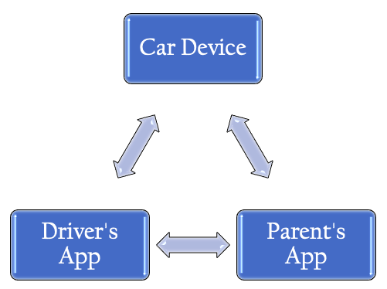
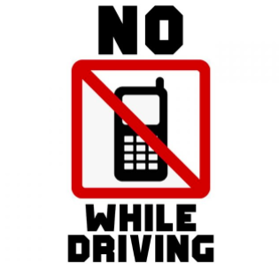
Problem and Project Statement
[1]
Notes:
This project was introduced last school year by our client Christine after her teenage daughter got into a car accident while texting and driving. Therefore she decided to do something to prevent teenagers from getting into car accidents because of their phones. To achieve this goal, we are going to limit the teenager’s access to their phones. To limit phone access we will design a system that prevents distractions by blocking notifications and applications from the driver’s phone while the car is driving. The system consists of three components; a car device, driver’s application, and a parent’s application.
1) The car device will read the car gear and send a signal to the driver’s and parent’s apps. 2) The driver’s app will block all notifications from the driver’s phone and will not allow that phone to be used while the car is driving except for navigation and music. 3) The Parent’s app will check if the driver’s app is in use and if the car device is functioning.
This project will help reduce car accidents, make driving safer for teenagers, and reduces parent’s stress regarding new teenage drivers.

Slide 4
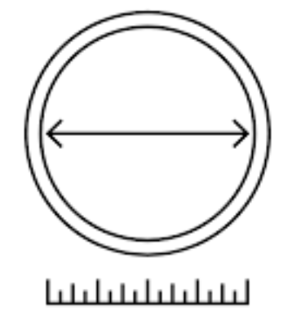
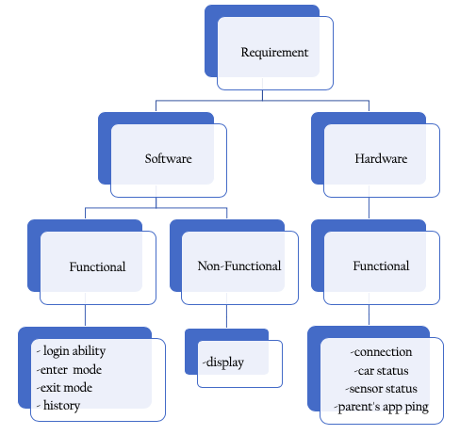
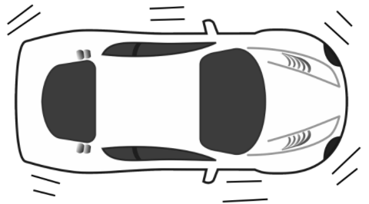
Operational Environment and Requirements
[3]
[4]
[2]
Notes:
The operational environment is a challenge since the On-Board Diagnostics unit (OBD) must be in the car at all times. Therefore, the OBD must sustain a good working condition under Iowa’s temperature, which fluctuates between -20 to 110 degrees Fahrenheit. The OBD must also be able to withstand speed bumps and minor car accidents. Finally, the size of the unit must not interfere with driving and should be as small as possible.
Regarding requirements, the project has software and hardware requirements. There are four hardware requirements and all of them are functional. first, The OBD sensor shall connect to the driver’s app within a certain range. second, The sensor should detect the status of the car; wither in use or not. third, The sensor should detect the connection status of itself. And fourth, The OBD sensor shall react to the parent’s app’s ping within a certain range.
There are also 4 functional requirements for the software. 1)all users should be able to login to their account. 2) the app gets into driving mode after receiving a signal from the OBD sensor. 3) similarly, the app should exit driving mode after getting a signal from the sensor. 4) the app history must be saved. Lastly, the software has one non-functional requirement which is the app information display must be clear and readable.

Slide 5
Assumptions and Deliverables
Assumptions:
1- Car has a computer.
2- Parent’s checking the car device.
3- Driver and parent use smartphones.
4- Low cost.
Deliverables:
1- On-Board Diagnostic Unit.
2- Application.
3- Instruction Manual.
Notes:
To be able to use the road safe phone-case system, we assume the following, 1) the car has a computer and an OBD port, 2) parents are checking the car device regularly to check if the device still plugged into the car, 3) we also assume that both the driver and the parent are using smartphones. 4) we must assume a low cost for the system for it to be accessible for all parents.
The finished product has 3 deliverables; an on-board diagnostic unit that reads the car status. An application that has two accounts; 1 for the driver and another for the parent. And an instruction manual explaining the step-by-step system setup.

Slide 6
Proposed Approach
Stop phone if car is on
Timer locked device
Second key
Stop car if phone is on
Phone Case
Notes:
Our client initially envisioned a phone case. The case design holds the drivers phone as collateral for the car key. After discussing possible solutions, and our team’s strengths with the client, we proposed a new approach. This approach incorporated a wireless connection between the phone and car. This connection would know when both are on. From there, the system limits the car when the phone is on, or limits the phone when the car is on. We decided on limiting the phone. Altering the vehicles system presents safety risks. Also changing fundamental operations may violate terms and conditions set by the manufacturers.

Slide 7
General Design
When car is on, phone is limited
Determine when car is on
Limit phone’s features
Engine Control Unit
Mobile app
OBD-II Scanner
Raspberry Pi
Restrict texting, outside app usage, etc.
Allow music, GPS, calls
Notes:
After deciding on limiting the phone when the car is on, the question was how? The team enjoyed two 3 hour meetings trying to answer this. We started with the phone. The client wanted music, GPS, and calling to be available at all times. These are understandable requests, that prevent us from entirely disabling the device. The team chose to create an app that limits phone accessibility to required features. Next is understanding when the car is on. All cars since the 90’s have an Engine control unit or ECU. This outputs engine metrics as soon as the vehicle is started. The metrics will determine which gear the car is in. To read the ECU requires an On board diagnostics or OBD scanner. The OBD scanner interprets the ECU into useful data for an arduino. And if we make this arduino bluetooth capable, there is a link between the engine metrics and phone. So the ECU is read by the OBD-II scanner for the arduino. The arduino sends the information via bluetooth to the phone. The mobile app interprets the bluetooth message and restricts phone capabilities, while allowing necessary functions.

Slide 8
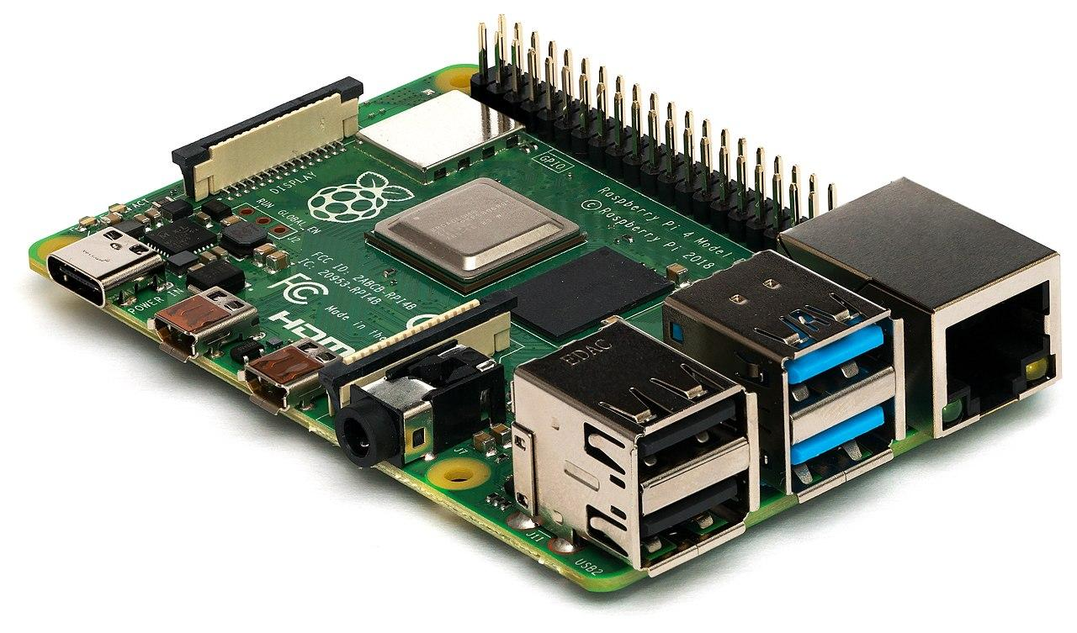
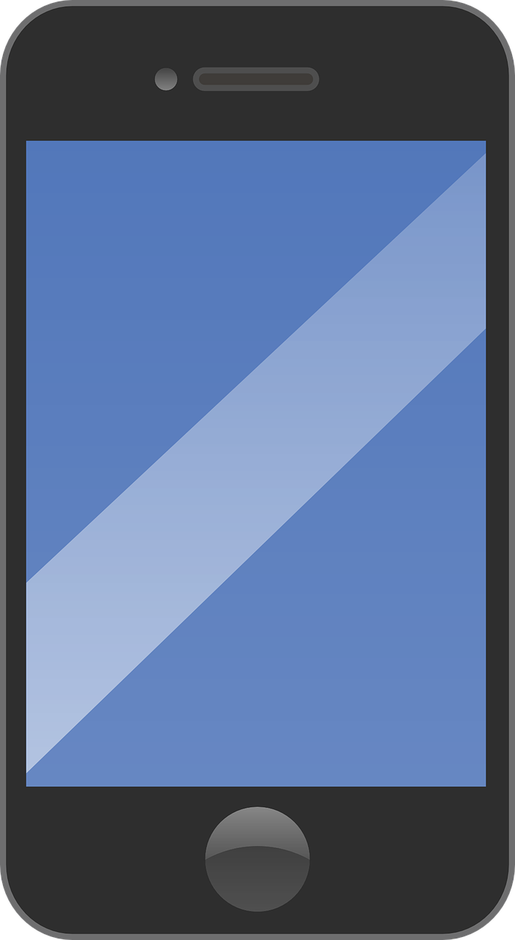
Conceptual Sketch
OBD-II Scanner
Bluetooth
Notes:
This first sketch is a very fundamental view of our project. This sketch breaks down our project to 3 manageable components. First is the car and reading the engine metrics. Next is the arduino. It interprets the car’s data and sends it to the drivers phone via bluetooth. The final piece is the mobile app. The app must limit the phone’s features.

Slide 9
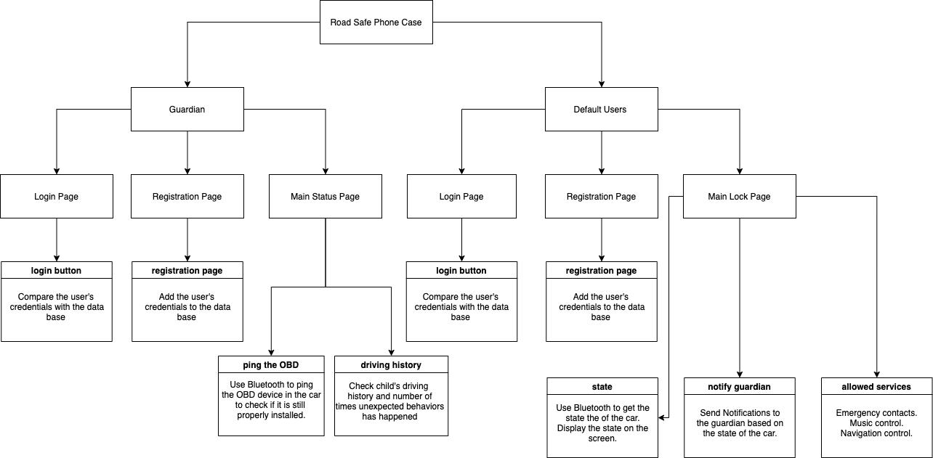
Conceptual Sketch
Notes:
This sketch details the flow of the mobile app. The app will have two user types. The default user is the driver, and guardian is their parent. Both users will have an initial and one time registration and login page. Afterwards, they open to a home page. The main page for the driver updates the state of the vehicle. The driver can access music, GPS, and phone calls from here. The guardian’s home page reports driving history. The gaurdian can also ping the arduino to ensure the system hasn’t been tampered with.

Slide 10
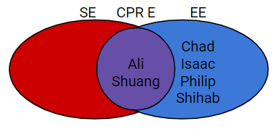
Development Process
Ali and Shuang
Isaac
Chad
OBD-II Scanner
Bluetooth
Shihab and Philip
Notes:
The venn diagram above breaks down the majors on our team. The sophisticated chart shows the team is skewed towards a hardware background. Fortunately, this project has something for everyone. The fundamental sketch seen earlier outlines our agile development process. Chad chose to read the ECU using an OBD scanner that relays information to our arduino. Isaac is working on interpreting and encoding the data. Shihab and myself were assigned to bluetooth operations. The computer engineers being Ali and shuang are developing apps that limit the drivers phone. The app will be available in iOS and android.

Slide 11
Statement of Work

Slide 12
Similar Products
Software products that use the GPS data to help the user avoid using their phones.
Hardware products that lock the phone.
A combination of hardware and software that help the user avoid distractions from their phone.

Slide 13
Technology Considerations and Risks
Pros and cons of using a combination of hardware and software:
Pros include: flexibility, reliability and future improvements.
Cons include: difficulties during integration and overall cost.
Some of the risks we face:
The COVID-19 pandemic.
Failing to deliver a cheap product.

Slide 14
Proposed Milestones and Expected Results
Our project is divided into five milestones that leads to our goal:
Stage 1: SW: Beta app complete. HW: Bluetooth is set up, OBD sensor connects to Raspberry Pi and sends data through the Pi.
Stage 2: Integrate SW and HW.
Stage 3: Design a chip to replace the Raspberry Pi to reduce the power needed and size for hardware.
Stage 4: Integrate SW and HW.
Stage 5: Beta Testing.
Our expected results:
A functional prototype by the end of Spring 2020.
A fully functional product that meets the expectations of our client, by the end of Fall 2020.

Slide 15
Timeline, Feasibility Assessment, Personnel and Other Effort Requirements
Notes:
Hi this is Shuang. I’m going to talk about the overall project planning which includes the timeline, feasibility assessment, personnel and other effort requirements.

Slide 16
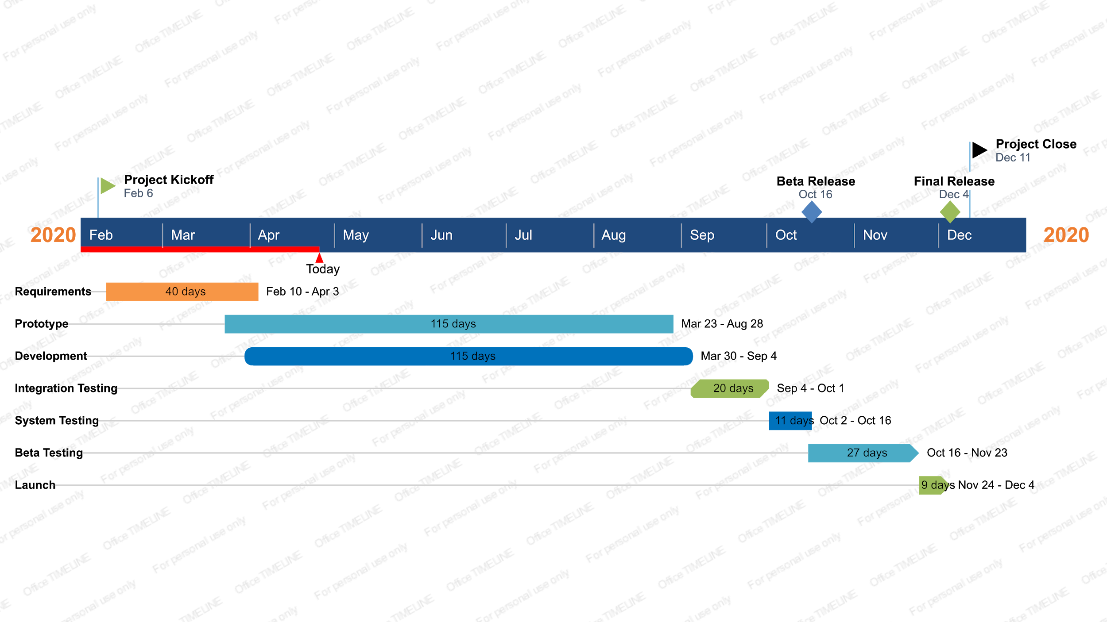
Project Timeline (Chapter 4)
Notes:
Hi this is Shuang. I’m going to talk about the overall project planning which includes the timeline, feasibility assessment, personnel and other effort requirements.
Displayed is the Gantt chart for this project, which kicked off on February 6 2020. Our complete development cycle are divided into 7 stages. First is the Requirements Definition stage which has been completed as of April 3rd. As we wrapped up the requirements definition stage, we started hardware prototyping on Raspberry Pi on March 23rd. In our project the hardware prototyping and software development are happening in parallel to each other, as we require some app features to test certain hardware functionality such as the bluetooth programming. We plan to have the prototype on Raspberry Pi ready by August 28, then start migrating features from the Pi to our own microcontroller. Software and Hardware Integration testing is planned to start on Sept 4th. Then System Testing will start on Oct 2. We plan to release a Beta version on Oct 16 to designated testers, then work on the feedback over the next month until Nov 23. Final adjustment period will be from Nov 24 to Dec 3, followed by the official release on Dec 4 which marks the completion of the project.

Slide 17
Feasibility Assessment (Chapter 4)
Technical Skills
Mobile dev
Microcontroller and sensor programming
Potential technical difficulties
Bluetooth connection between Microcontroller and Android/iOS app
OBD-II sensor reading
Notes:
Our team has performed a feasibility assessment for the project idea in terms of the technical expertise it requires and potential technical challenges during implementation. This project has both a hardware component and a software component. Our team’s expertise match well with the project because ⅓ of the team are Computer Engineering majors who has prior experience in mobile development, and ⅔ of the team are Electrical Engineering majors with experience operating microcontrollers.
One of the area where we do not have experience in is using app to read data via BLE from a specific microcontroller. However we were able to find tutorials that explain the process from both software and hardware perspective, which gave us a good starting point to connect these components together.
The other technical difficulty was to use an OBD-II sensor to read the status of the car because we did not have any prior experience using this sensor. We decided to move forward with the datasheet given, As of now our hardware team has successfully configured the sensor to read data from the OBD card and output it on the Raspberry Pi.
Based on these factors, after the analysis we have decided that the project is feasible to be completed in one year for our team.

Slide 18
Personnel Effort Requirement (Chapter 4)
Personnel | Task
Chad Korby | OBD-II reader
Shihab Al Balushi | Bluetooth Protocol
Philip Markose | Bluetooth Protocol
Isaac Kosgey | Bluetooth Protocol
Ali Almadani | Android Development
Shuang Li | iOS Development

Slide 19
Other Resource Requirement (Chapter 4)
Parts
OBD-II sensor
Raspberry Pi Microcontroller
Development Tools
Android Studio
Xcode

Slide 20
Interface Testing
Software to hardware interfacing will be done through Bluetooth 4.0 (Bluetooth Low Energy)
Hold Up due to COVID - Software sends installing packages to hardware team to perform tests
Notes:
This is Chad Korby and I am going to be explaining to you what our testing and implementation progress has been so far and our future implementation plans. Interface testing is a crucial part of our project. It is what ensures that our software and hardware have a stable and efficient way to transmit data back and forth. For our project, we are going to be using bluetooth 4.0, otherwise known as bluetooth low energy, to connect our software and hardware devices together. Our interface testing will consist of establishing a connection, making sure the connection is able to stay secure, and automatically connecting after the first initial connection. We will also test the transmitting and receiving format of our data and the completeness of the data being sent, so basically making sure that no crucial data is missed while interfacing between hardware and software. Our progress so far has been connecting our Raspberry Pi to an iPhone and Android phone using Bluetooth 4.0. iOS application has also been able to discover bluetooth devices. Hoping to be able to send data, but due to COVID-19, we have been unable to do this. Though when we make more progress, our plan is to have the software team send the installing packages to the hardware team and walk them through how to implement it and test it with our hardware. We can them video call to discuss the results.

Slide 21
Software and Hardware Used For Testing
Software
iOS testing - Xcode with built-in framework XCTest
Android testing - Mockito library and Android Studio emulator
Hardware
OBD-II testing - PiCan2 bus, Raspberry Pi running Raspbian
Bluetooth testing - Raspberry Pi running Raspbian. Android running Android Studios, iOS custom application
Notes:
The software iOS testing will be performed on Xcode using the built-in testing framework XCTest. This framework allows programmers to make placeholders for Systems Under Test and assess their functionalities by comparing the actual output with expected output. Android testing will be performed in Android Studio. Initially we are going to use the Mockito library for unit testing and to run behavioral tests. Once we are ready to start performing integration testing, we are going to use the Android Studio emulator. The final android testing will be done using a physical android phone. This will be used to test the interfacing the functionality of the app. For hardware, all of our testing is going to be done using the Raspberry Pi and Raspbian. For OBD-II data scanning testing, we will be using the PiCan2 bus connected to the OBD-II output on the car using a by a DB9 to OBD-II cable. The PiCan2 bus will then connect to the in/out pins on the Raspberry Pi and translate the OBD-II data into something that is readable for the Raspberry Pi. For bluetooth testing, we will be using Android Studios to test all Android bluetooth functionality and the iOS application designed by our software team to test all iOS bluetooth functionality.

Slide 22
Functional Testing
Software
Unit testing - Individual functionalities
Integration testing - Making sure new functionalities do not impact old features
System testing - Ensuring that all functionalities do not interfere with each other
Acceptance testing - Beta testing without developer interface
Hardware
Unit testing - OBD-II scanner, bluetooth connection
Integration testing - bluetooth protocol, OBD-II signal processing
System testing - Sending signal from OBD-II processing over bluetooth
Acceptance testing - Performs with client’s phone and car
Notes:
For software Unit Testing, we will be testing individual functionalities with complete statement coverage for every basic block and branch coverage for every outcome of a branch. An example of this is when the teenage user navigates away from the app while driving, the real-time change of signal must be recorded in the database. For software Integration Testing, we will be testing the interface between modules that are interconnected with each other. So when adding a new feature, old features are not impacted in any way. For example, by adding app exit detection, the app can still be connected to our bluetooth device installed on the car. Software System Testing will test that all functionalities cooperate together and do not interfere with one another. This will be testing the complete functionality of the app. For software acceptance Testing, we will release Beta testing and let testers operate the device without developer interference. This testing is in place to ensure the compliance between the testing version and the initial customer needs. For Hardware, Unit Testing will be testing individual functionalities, such as the connection between the hardware device and the user's phone through bluetooth. The Integration Testing will be testing multiple functions together, for example, whether the hardware device will be able to send the OBD-II data through bluetooth to the software phone application. Also, making sure that the hardware and software interfaces are able to communicate through an efficient bluetooth protocol. The System Testing will be done when all hardware components are finished and put together. This will be testing if the driver of the car is able to use their phone while the car is running. Lastly, Hardware User Acceptance Testing will be ensuring the hardware device is able to meet the client’s requirements, which is that the finished product must be able to work with an iPhone 10 and 2015 Ford Escape.

Slide 23
Non-Functional Testing
Software
Security - Testing whether the software is able to be tampered with
Performance - Testing that the phone application should be able to run efficiently
Compatibility - Testing if the phone can work with older and newer models of Android and iOS devices
Usability - The phone application is comprehensive
Hardware
Security - Test that all functionality is unable to be altered
Performance - Test that data can be sent and read at an optimal rate
Compatibility - Performs with all types of phones and cars
Usability - The device is able to easily be used in situations other than our clients
Notes:
Non-functional testing is broken up into 4 different categories. The first being security testing. For software, this is going to be testing whether the teenage user of our product will be able to hack into the phone application and disable the feature that prevents them from using their phone. The second non-functional test is for performance. This will be to make sure the phone application runs optimally with no more than a .5 second delay in data transmission. Compatibility testing is the third non-functional test we will perform. For software, this will be testing the application on older and newer models of Android and iPhone devices. Lastly, usability testing will be testing that the phone applications are comprehensive and easy to use. All of these tests will ideally be performed through beta testing. For hardware, security tests are going to be testing whether the teenage user is able to hack into the Raspberry Pi and disable features that allows it to communicate between the phone and car. Performance testing for hardware will be similar to software, in that we will be testing that data is sent with no less than a .5 second delay. For hardware, compatibility testing is going to be testing that our product is able to read the OBD-II data from all models of modern cars and that it is able to connect to the bluetooth of all modern iPhones and Androids. Lastly, the usability test for hardware is going to be testing our product in scenarios other than our clients. For example, whether our product is able to be used in a smaller car with less room to install the hardware device.

Slide 24
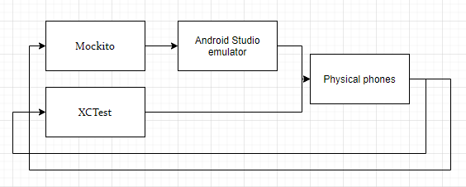
Testing Process
Software
Framework XCTest
Library Mockito
Emulator
Hardware
Raspberry Pi running Raspbian
PiCan2 OBD-II scanner
iPhone and Android both used with Raspberry Pi for bluetooth test
Notes:
For the testing process for software, all unit testing will be done by using XCTest for both iPhone and Android devices. For integration testing, we will use Mockito with the Android Studio emulator with the Android phone. For iPhone integration testing, we will be using the application developed by our software team paired with an iPhone. For hardware OBD-II data reading tests, we will do our unit testing using just the Raspberry Pi with the PiCan2 bus connected to the cars OBD-II port. We will first scan for any readable data from the car and then specifically scan for the RPMs of the car. From there, we will do integration testing by writing a code that takes the RPM data to determine if the car is on or not and then try to send that data over bluetooth. To test the bluetooth, we are first going to pair the phones with the Raspberry Pi. We will then perform unit testing where we try to send a simple bit of a data from the Raspberry Pi to the phone using bluetooth. Next, we will do integration testing with both the OBD-II scanner and bluetooth data transmitter. Lastly, for system testing, we will use our applications with their respective phones that will be connected to the physical hardware device via bluetooth and perform intensive system testing, where we test every function of our product.

Slide 25
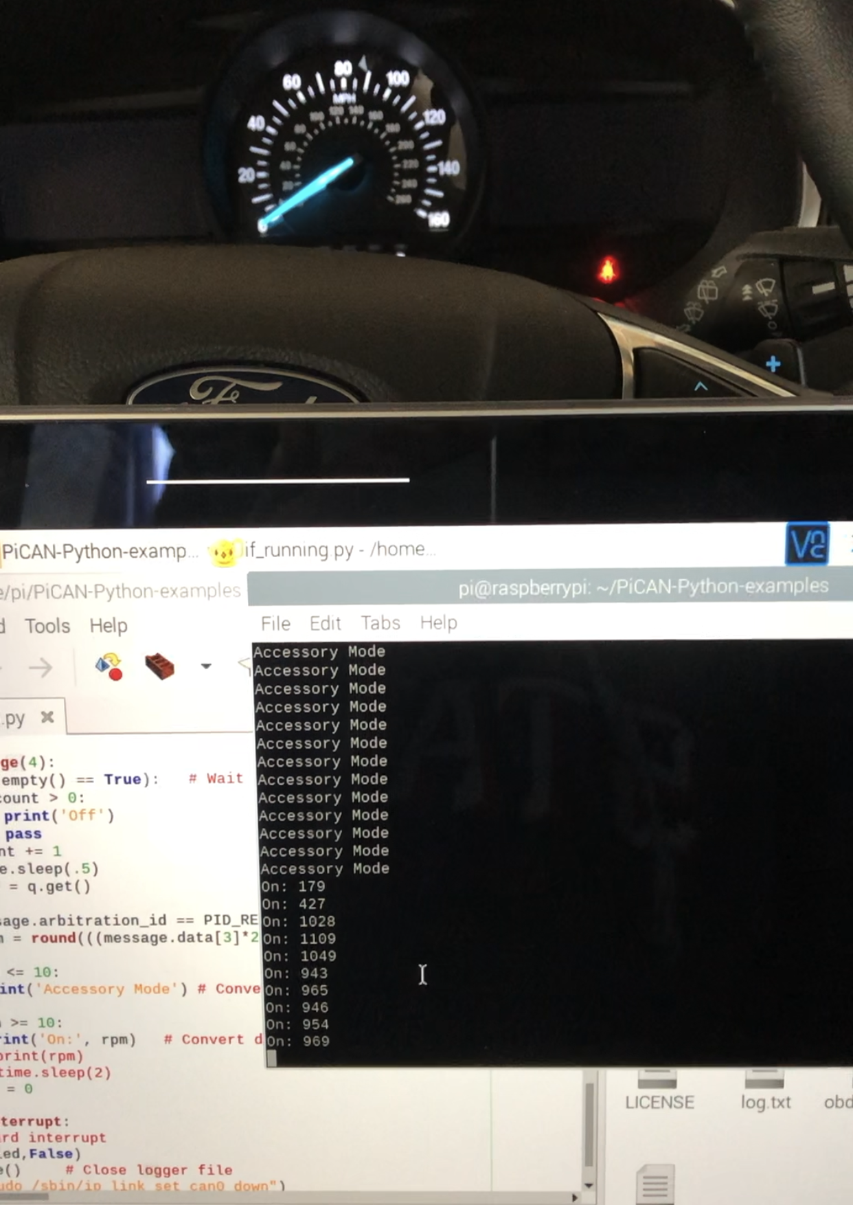
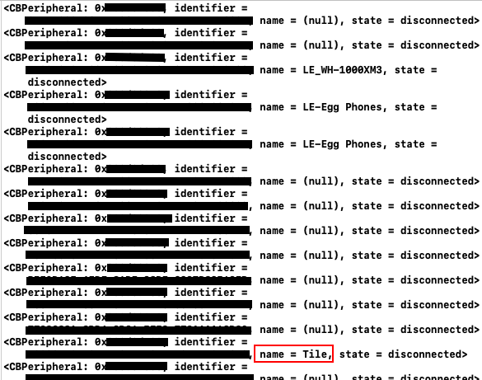
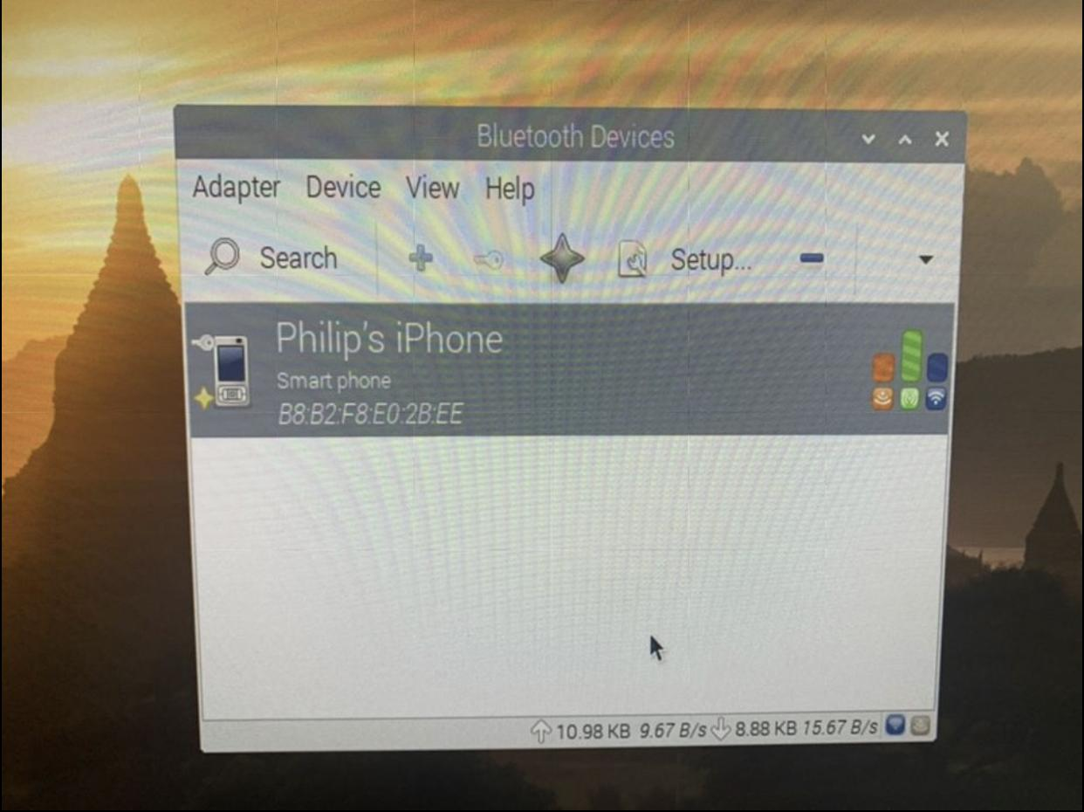
Testing Results
Software
iOS application detects pairable devices (image below shows “my Tile” as pairable to iOS application)
Hardware
Connected to Raspberry Pi with both iPhone and Android
Read OBD-II data and ran program that was able to determine when the car was on, off, or in Accessory mode (image to left of test)
Notes:
So far, for software, we have been able to get our iOS application to discover nearby pairable devices. In the image in the bottom left, you can that the iOS application found a device called “Tile”, which is one of those bluetooth trackers you can attach to luggage. Of course, once we are able to meet in person, we will further this test by testing whether the iOS application can discover the Raspberry Pi. For the hardware side of our project, we have been able to connect an iPhone and Android phone to the Raspberry Pi. As you can see in the bottom right corner, Team member Philip displays that he is able to connect to his phone to the Raspberry Pi using Raspbian. The middle picture displays a picture of our successful OBD-II data reading test. We were able to write a program that reads the RPM of the car and determines whether or not the car is on. The picture shows a few seconds before and after the moment that the car is turned from Accessory Mode to on. While on, it also displays the RPMs of the car as well. When the car is turned off, it also outputs “off” to the terminal, which is not pictured.

Slide 26
Conclusion
Hardware
OBD-II
PiCAN2
Bluetooth
Raspberry Pi
Software
iOS Application
Android Application
Future Plans
Prototype
Notes:
This is Isaac and I am going to about the overall progress of the project. Our goal with this project was to create a product that would keep a teenager away from their phones while driving. Our client Mrs. Christine Shea-Hunt wanted this product so that she can keep her teenage daughter away from her phone whenever she was driving. So far, we have been able to make significant progress in the development phase of the project. We have been able to develop an app both for iOS and Android that will be connected to our hardware device through Bluetooth. For our hardware device, we have been able to read and decipher code from the vehicles ECU using a PiCAN2 scanner. We have also been able to create a Bluetooth connection between the Raspberry Pi and both Android and iOS phones. Our initial plan was to make a prototype by the end of this semester but due to unavoidable circumstances specifically Covid-19, we were not able to do so since most our group members were not in school. For now, our future plans include making a prototype of our device within the first few weeks of the fall semester.

Slide 27
References:
[1] A. D. Venecia, “Countries That Ban Cell Phones While Driving,” CellularNews, 30-Mar-2020. [Online]. Available: https://cellularnews.com/news/archive/car-ban/. [Accessed: 25-Apr-2020].
[2] “What's the ideal temperature for running?,” Canadian Running Magazine, 08-Aug-2019. [Online]. Available: https://runningmagazine.ca/sections/training/whats-the-ideal-temperature-for-running/. [Accessed: 25-Apr-2020].
[3] “Car Vibration Inspection & Repair in Hamilton,” Grimmer Motors Hamilton, 04-Jan-2018. [Online]. Available: https://grimmermotors.co.nz/car-vibrating-inspection-repair/. [Accessed: 25-Apr-2020].
[4] “Pandora Ring Size Chart & Guide - Find Your Fit: Pandora HK,” Pandora. [Online]. Available: https://hk.pandora.net/en/size-guide/rings.html. [Accessed: 25-Apr-2020].
[5] M. Katz and M. Katz, “iOS Unit Testing and UI Testing Tutorial,” raywenderlich.com, 08-Apr-2019. [Online]. Available: https://www.raywenderlich.com/960290-ios-unit-testing-and-ui-testing-tutorial. [Accessed: 23-Apr-2020].
[6] A. S. Huang and L. Rudolph, in Bluetooth essentials for programmers, New York, NY: Cambridge University Press, 2007.
Notes:
These are the books articles we used to help us in understanding more on the project and the tools we were going to use.

